Slide 1
Machine Learning for Anomaly Detection

Slide 2
Any data point/observation that deviates significantly from the other observations is called an Anomaly/Outlier. Anomaly detection is important and finds its application in various domains like detection of fraudulent bank transactions, network intrusion detection, sudden rise/drop in sales, change in customer behavior, etc.
Many techniques were developed to detect anomalies in the data.

Slide 3
Anomaly Detection is the technique of identifying rare events or observations which can raise suspicions by being statistically different from the rest of the observations. Such “anomalous” behaviour typically translates to some kind of a problem like a credit card fraud, failing machine in a server, a cyber attack, etc.
An anomaly can be broadly categorized into three categories –
Point Anomaly: A tuple in a dataset is said to be a Point Anomaly if it is far off from the rest of the data.
Contextual Anomaly: An observation is a Contextual Anomaly if it is an anomaly because of the context of the observation.
Collective Anomaly: A set of data instances help in finding an anomaly.

Slide 4
Anomaly detection can be done using the concepts of Machine Learning. It can be done in the following ways –
Supervised Anomaly Detection: This method requires a labeled dataset containing both normal and anomalous samples to construct a predictive model to classify future data points. The most commonly used algorithms for this purpose are supervised Neural Networks, Support Vector Machine learning, K-Nearest Neighbors Classifier, etc.
Unsupervised Anomaly Detection: This method does require any training data and instead assumes two things about the data ie Only a small percentage of data is anomalous and Any anomaly is statistically different from the normal samples. Based on the above assumptions, the data is then clustered using a similarity measure and the data points which are far off from the cluster are considered to be anomalies.

Slide 5
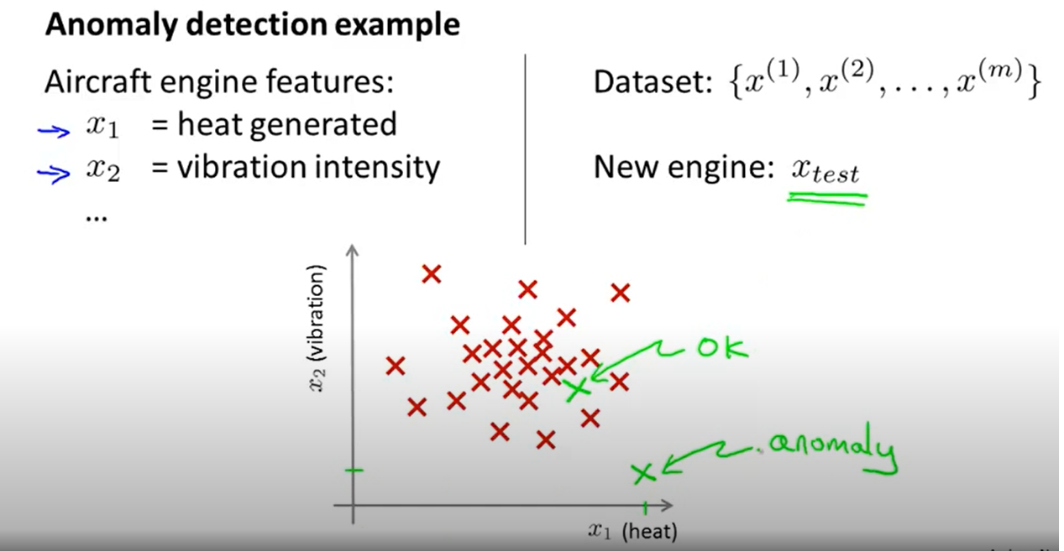

Slide 6
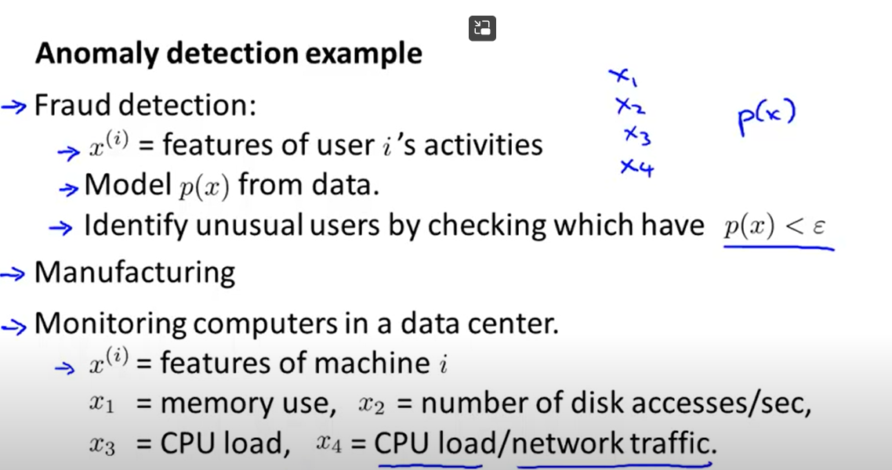

Slide 7
Another technique to find outlier
What is Isolation Forest?
Isolation Forest is a technique for identifying outliers in data that was first introduced by Fei Tony Liu and Zhi-Hua Zhou in 2008. The approach employs binary trees to detect anomalies, resulting in a linear time complexity and low memory usage that is well-suited for processing large datasets.
Since its introduction, Isolation Forest has gained popularity as a fast and reliable algorithm for anomaly detection in various fields such as cybersecurity, finance, and medical research.

Slide 8
In an Isolation Forest, randomly sub-sampled data is processed in a tree structure based on randomly selected features. The samples that travel deeper into the tree are less likely to be anomalies as they required more cuts to isolate them. Similarly, the samples which end up in shorter branches indicate anomalies as it was easier for the tree to separate them from other observations.

Slide 9
Let us look at the complete algorithm step by step:
When given a dataset, a random sub-sample of the data is selected and assigned to a binary tree.
Branching of the tree starts by selecting a random feature (from the set of all N features) first. And then branching is done on a random threshold ( any value in the range of minimum and maximum values of the selected feature).
If the value of a data point is less than the selected threshold, it goes to the left branch else to the right. And thus a node is split into left and right branches.
This process from step 2 is continued recursively till each data point is completely isolated or till max depth(if defined) is reached.
The above steps are repeated to construct random binary trees.

Slide 10
After an ensemble of iTrees(Isolation Forest) is created, model training is complete. During scoring, a data point is traversed through all the trees which were trained earlier. Now, an ‘anomaly score’ is assigned to each of the data points based on the depth of the tree required to arrive at that point. This score is an aggregation of the depth obtained from each of the iTrees. An anomaly score of -1 is assigned to anomalies and 1 to normal points based on the contamination(percentage of anomalies present in the data) parameter provided.

Slide 11
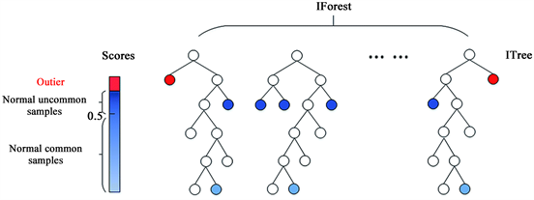

Slide 12
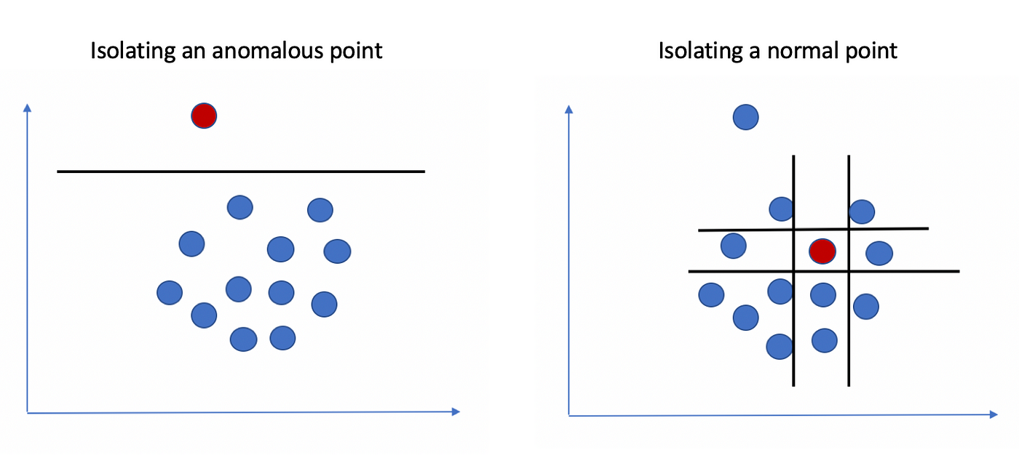

Slide 13
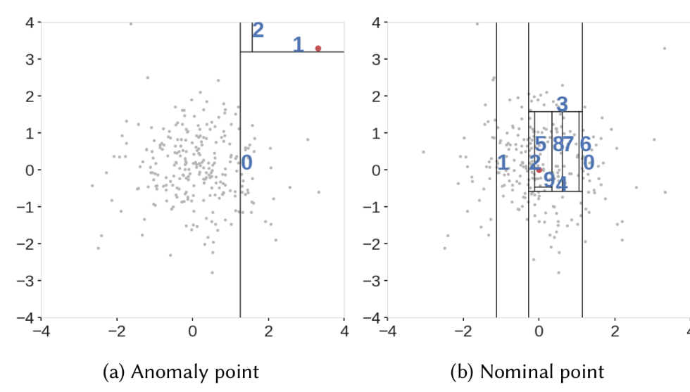

Slide 14
Applications of machine learning in Anomaly detection:
Fraud detection (e.g., in financial transactions).
Network intrusion detection.
Fault detection in manufacturing or systems.
Healthcare monitoring (e.g., detecting rare diseases).
Sensor data analysis (e.g., in IoT systems).

Slide 15
Reference
Lecture 15.1 — Anomaly Detection Problem | Motivation — [ Machine Learning | Andrew Ng ] - YouTube

